Slide 1
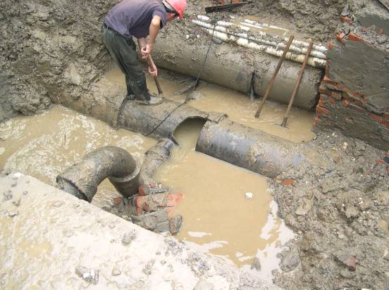
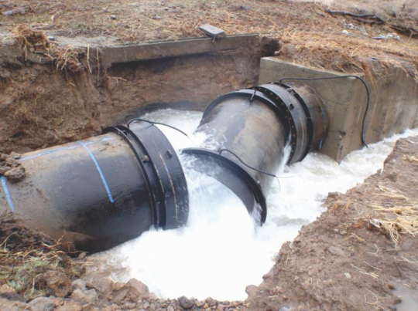
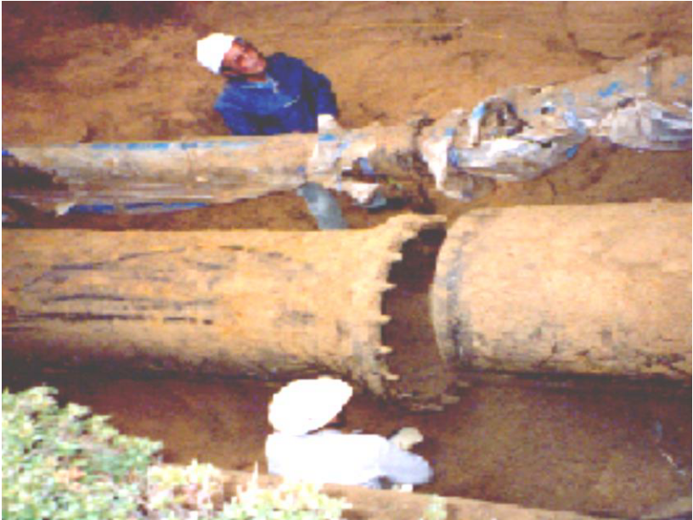
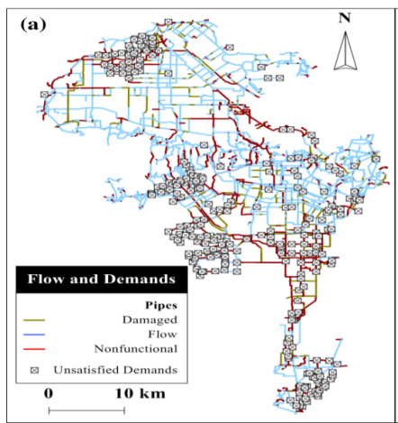
BJUT & DMU Workshop, 2019
Seismic Resilience Assessment
of Water Distribution System
Benwei HOU, Zhao HAN, Shan WU
College of Architecture and Civil Engineering, BJUT
July 9th, 2019

Slide 2
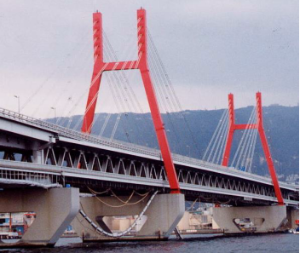
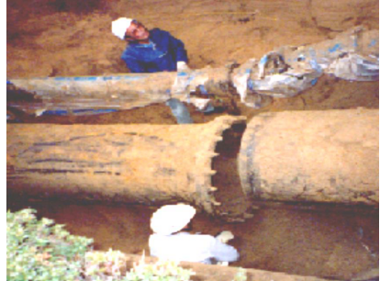
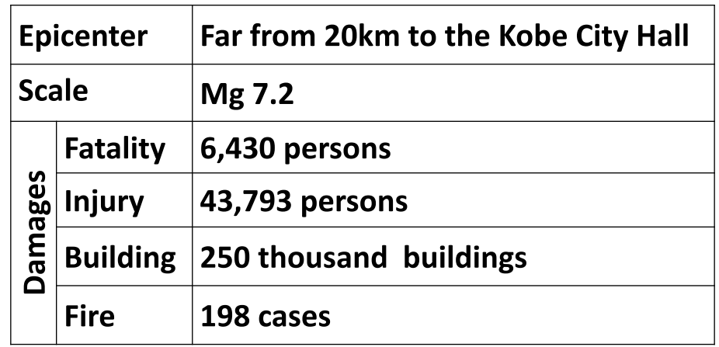
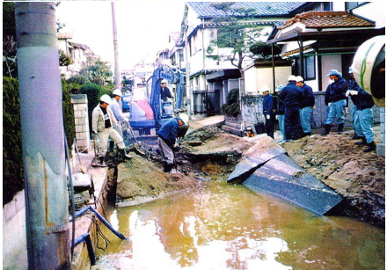
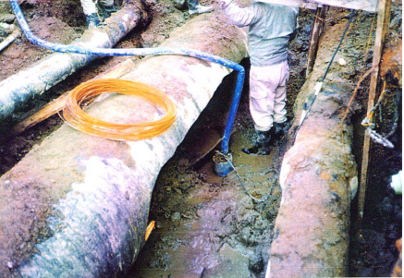
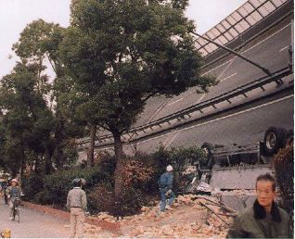
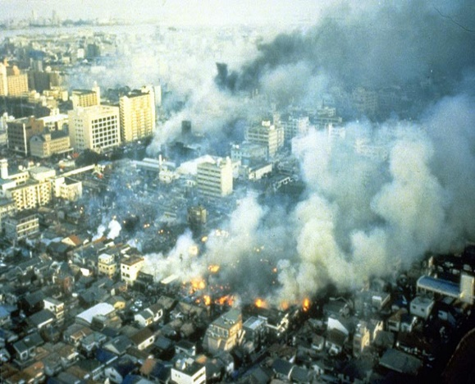
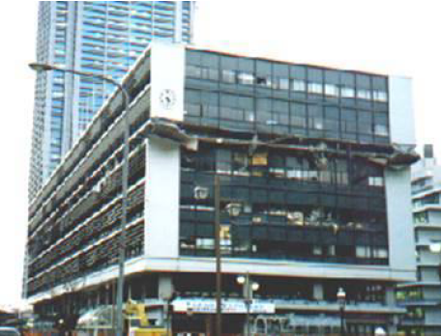
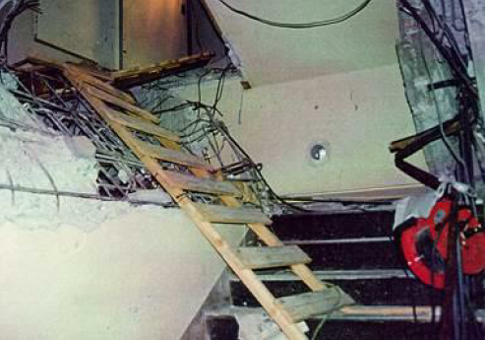
1. Earthquake Damages of Water Distribution System
The 1995 Kobe Earthquake (Kobe City Waterworks Bureau, 2018)
5:46:52 AM, January 17th, 1995
Damage of water supply pipelines
Expressway
Downtown
City Hall
Water Works office

Slide 3
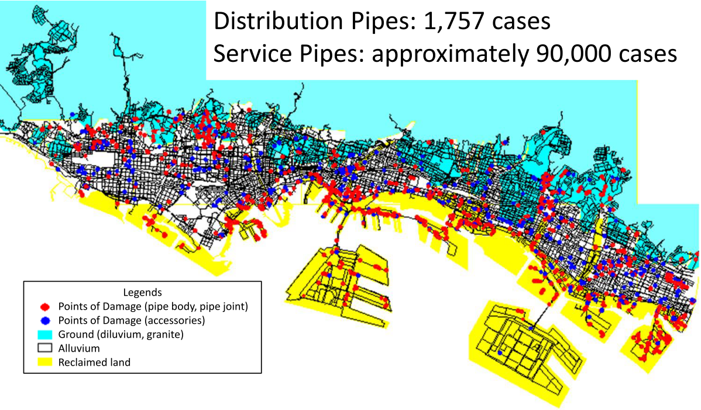
1. Earthquake Damages of Water Distribution System
The 1995 Kobe Earthquake (Kobe City Waterworks Bureau, 2018)
Completion date of emergency restoration: April 17th, 1995. (91 Days)
The post-earthquake damages and repair time of WDS is different from that of accidents.

Slide 4
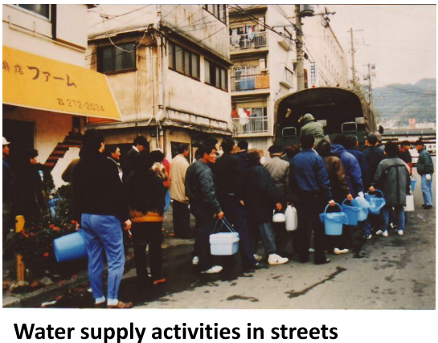
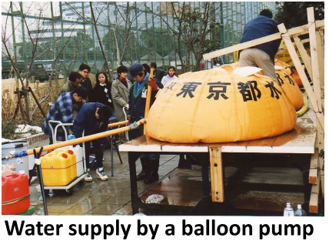
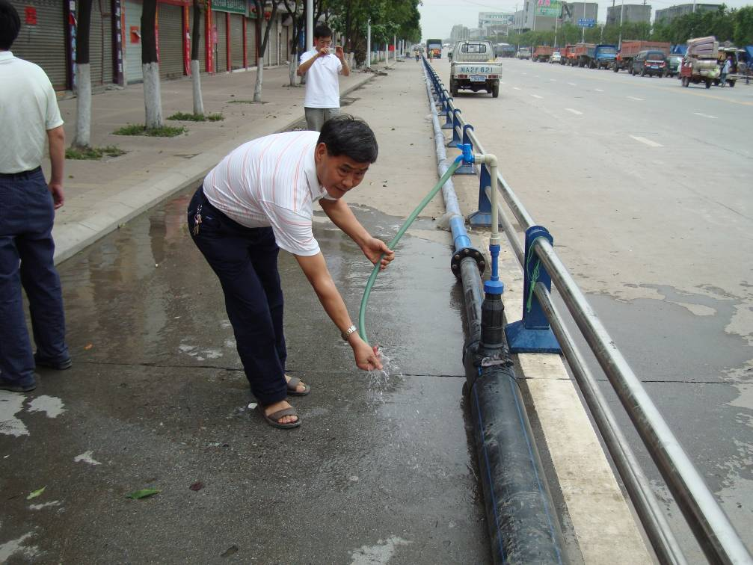
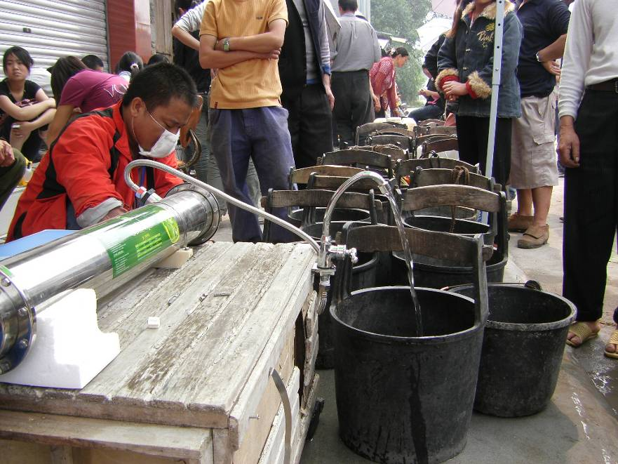
1. Earthquake Damages of Water Distribution System
The 1995 Kobe Earthquake (Kobe City Waterworks Bureau, 2018)
The 2008 Wenchuan Earthquake (14:28:04, May 12th, 2008; Ms 8.0)

Slide 5
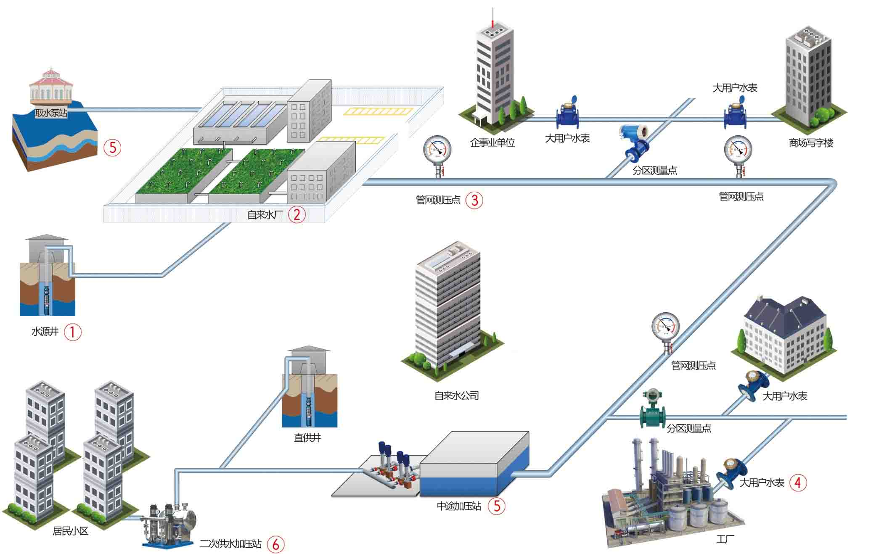
2. Seismic Resilience Assessment of Water Distribution System (WDS)
Surface Water
Water Treatment Plant
Aqueduct
Water meter
Pump Station
Pressure
Monitor
Distribution pipeline
Transmission pipeline
Underground Water
Resident User
Urban Water Supply System =Source +Transmission pipeline + Treatment plant +Distribution system

Slide 6
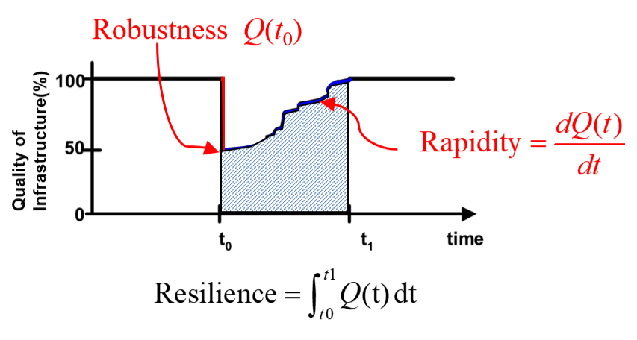
2. Seismic Resilience Assessment of WDS: Conceptual Model
Community seismic resilience: the ability of social units (e.g., organizations, communities) to mitigate hazards, contain the effects of disasters when they occur, and carry out recovery activities in ways that minimize social disruption and mitigate the effects of future earthquakes. (Bruneau et al., 2003)
Redundancy, Resourcefulness → Robustness, Rapidly. (Cimellaro et al., 2010)

Slide 7
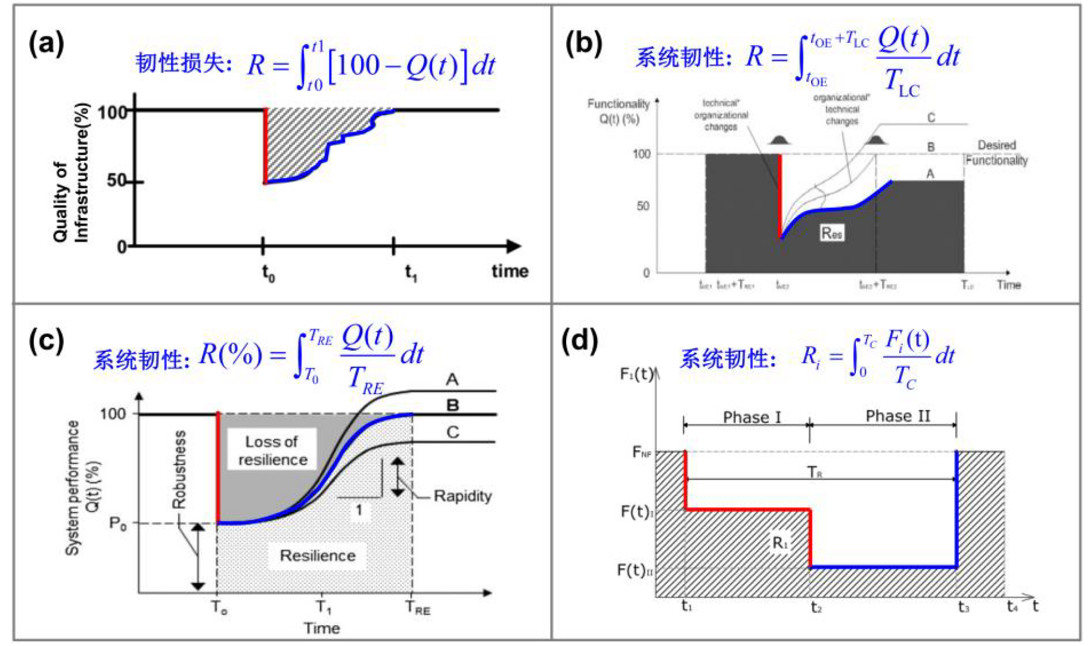
2. Seismic Resilience Assessment of WDS: Quantitative Models
Community Seismic Resilience (Bruneau et al., 2003)
Disaster Resilience (Cimellaro et al., 2010)
Building Resilience (Bonstrom and Corotis, 2014)
Seismic Resilience of Water tank (Cimellaro et al., 2015)

Slide 8
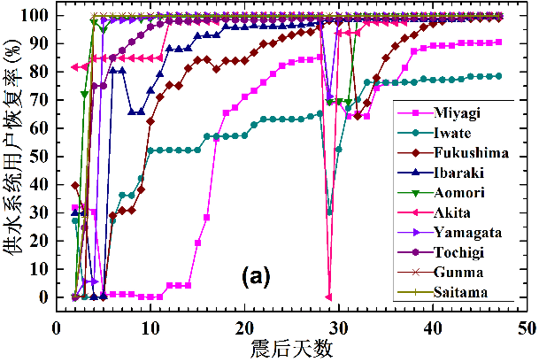
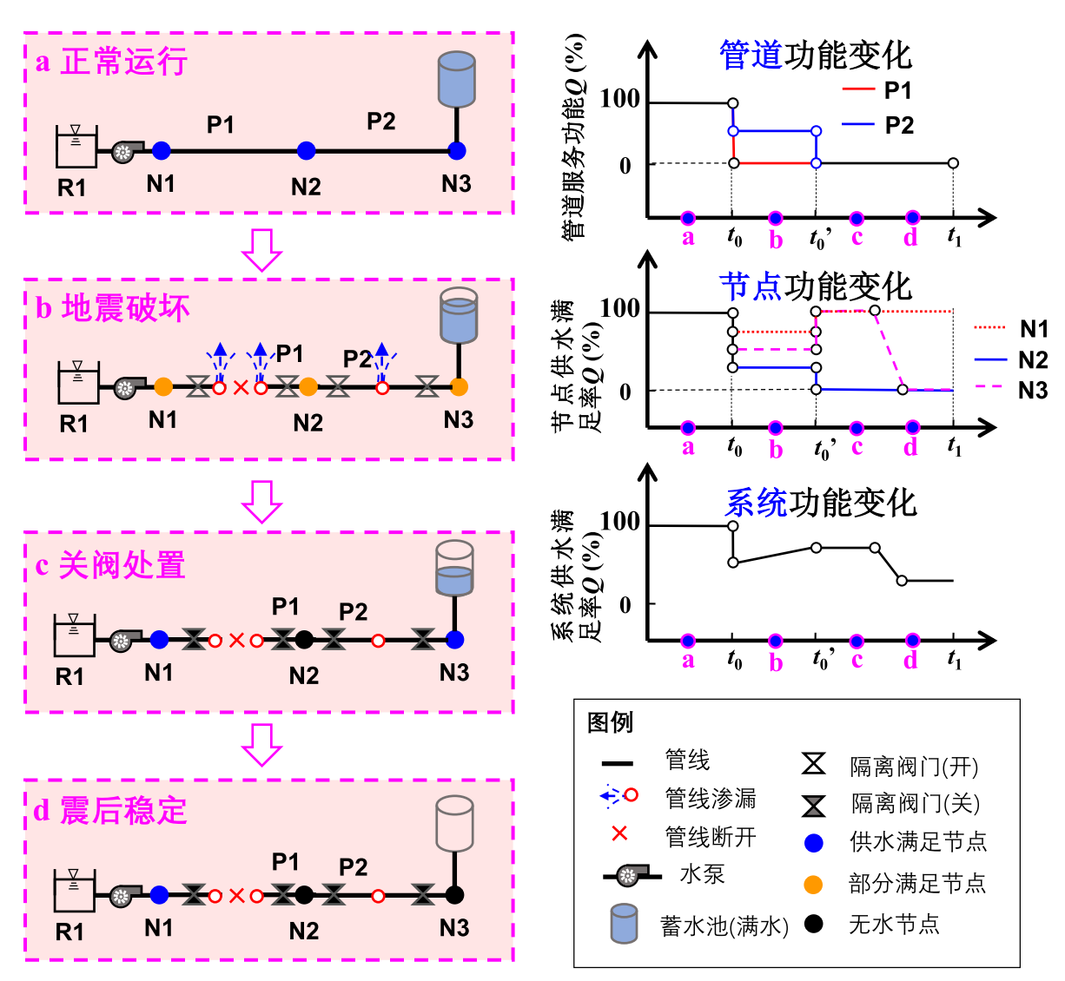
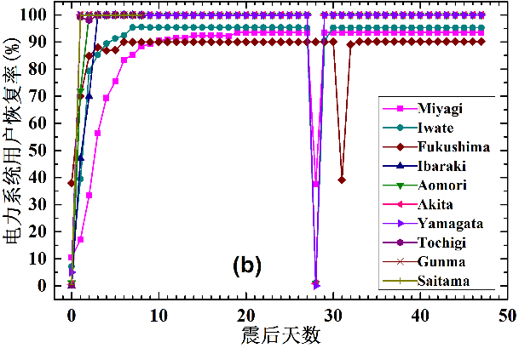
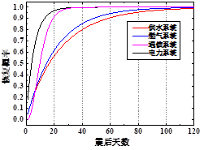
2. Seismic Resilience Assessment of WDS: Influence Factors
The post-EQ functionality recovery of WDS is slower than other Infrastructure systems；
Recovery process of seriously damaged areas is complex.
(Miyagi, Iwate, Fukushima)
Factors：
Damages,
Redundancy,
Pumps,
Tank,
Valves,
Operation strategy;
Complex time-varying process.
The 2011 East Japan EQ
32 EQs, M6.0~M9.0

Slide 9
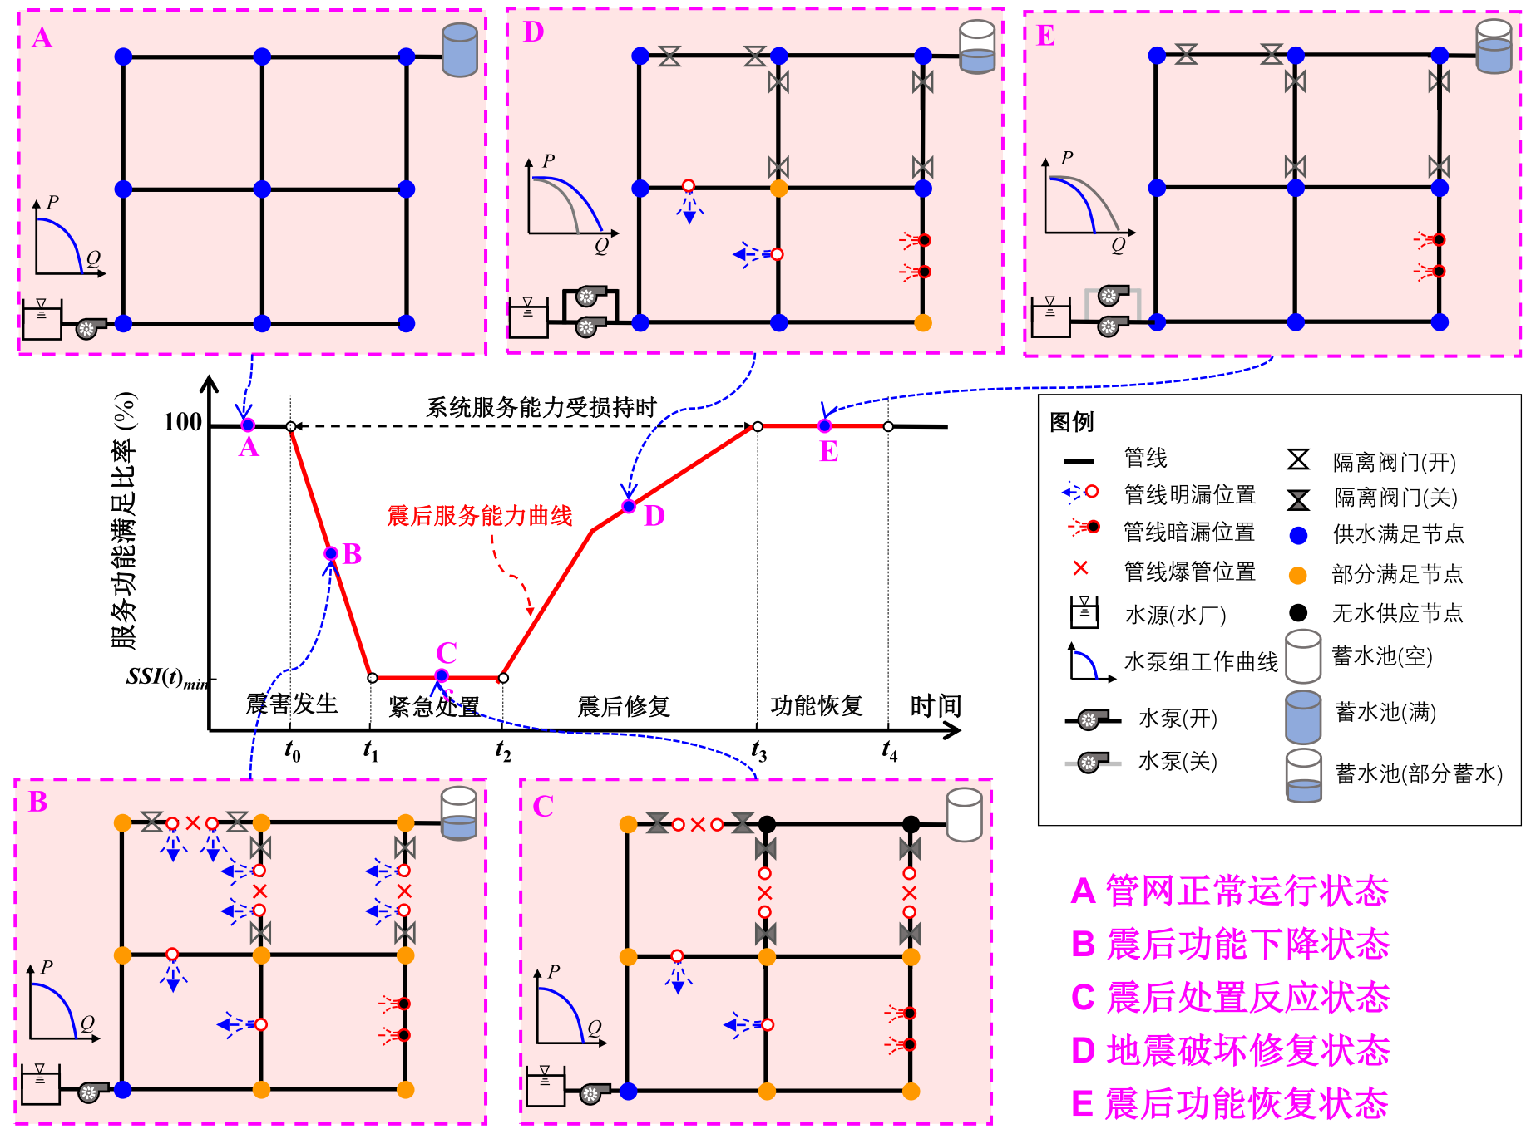
2. Seismic Resilience Assessment of WDS: Time-varying Functionality
Notes:
增加分析流程，和PDD的处理方法，GIRAFFE的处理方式。

Slide 10
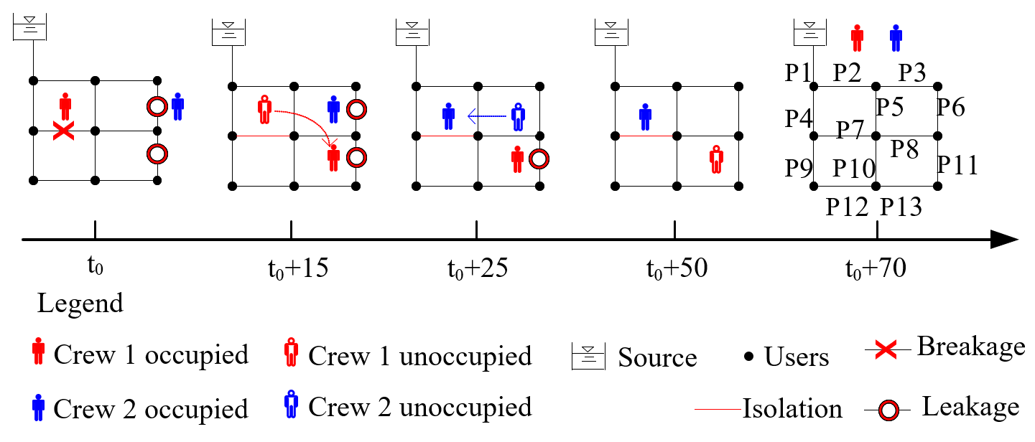
2. Seismic Resilience Assessment of WDS: Time-varying Functionality
Time-varying state of WDS
Hydraulic Models
Pressure Dependent Demand
Leakage
Breakage

Slide 11
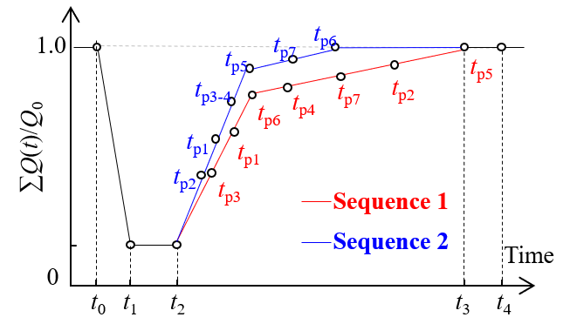
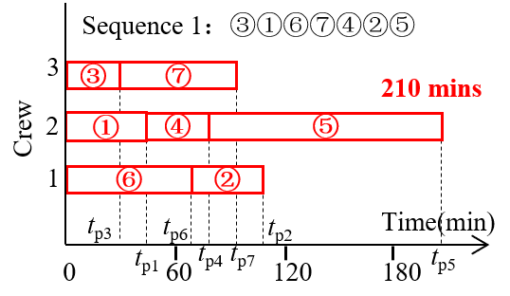
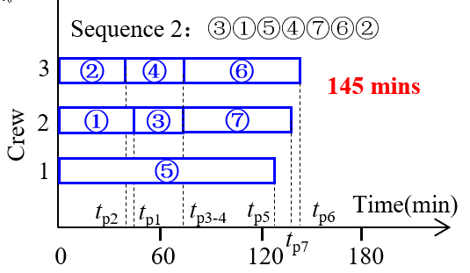
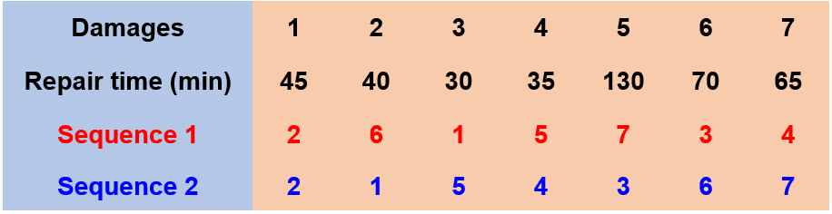
3. Recovery Activity Assignment: The priority of damaged pipeline reparation
Discrete Event Dynamic System Model (similar with Queuing system(排队系统))
Global Optimization Model; 全局最优化策略
Greedy Scheduling; 贪心策略
Heuristic Approach; 启发式/经验策略

Slide 12
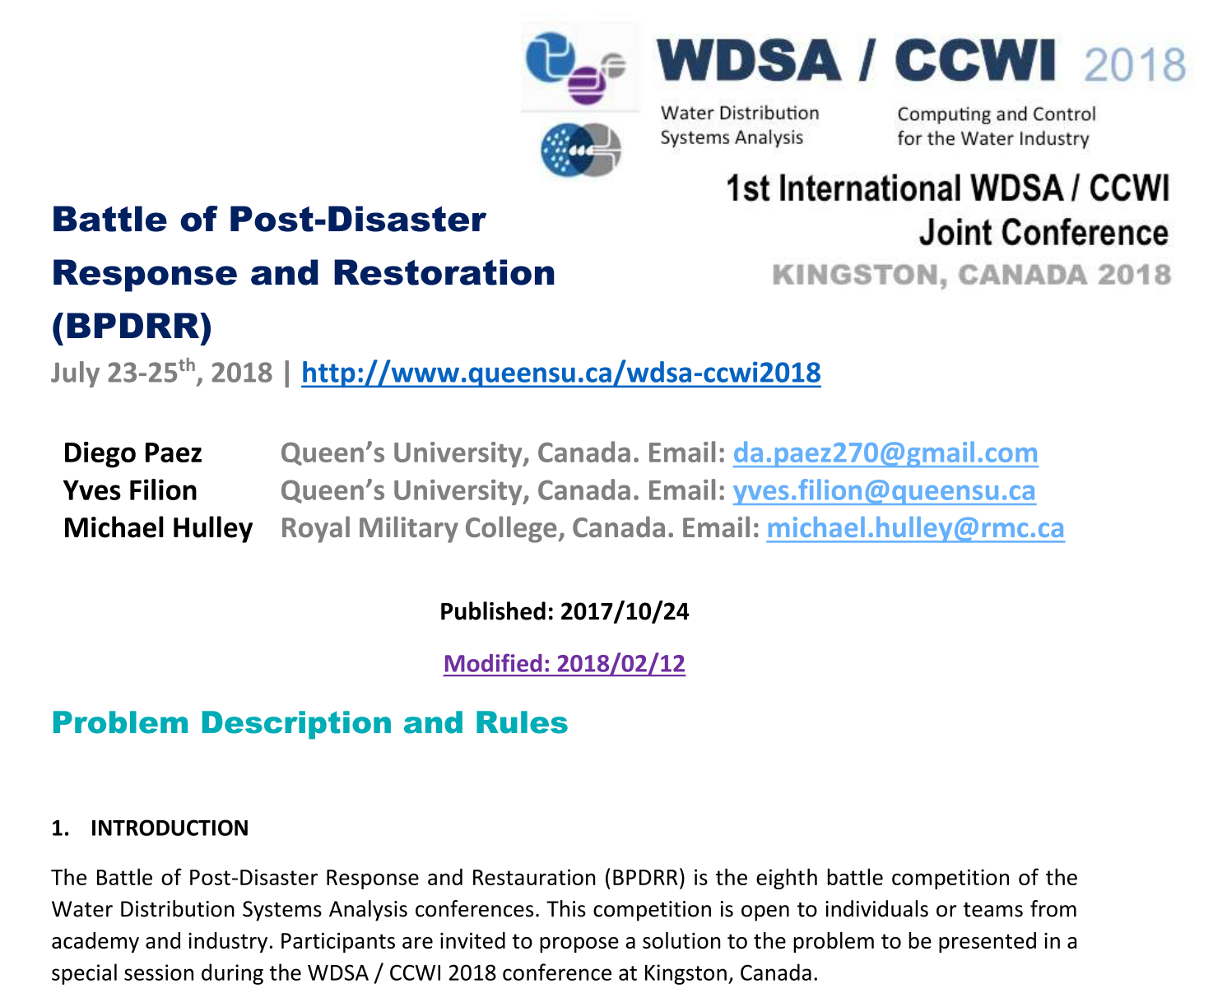
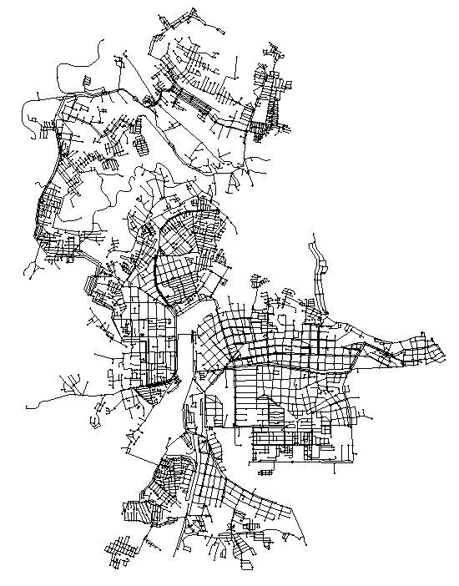
3. Recovery Activity Assignment: The priority of damaged pipeline reparation
WDS of B-City
4909 nodes; 6404 pipes;
1 Reservoir;
5 Tanks; 4 Pumps;
5 Damage Scenarios:
21-31 Breaks;
77-121 Leaks;

Slide 13
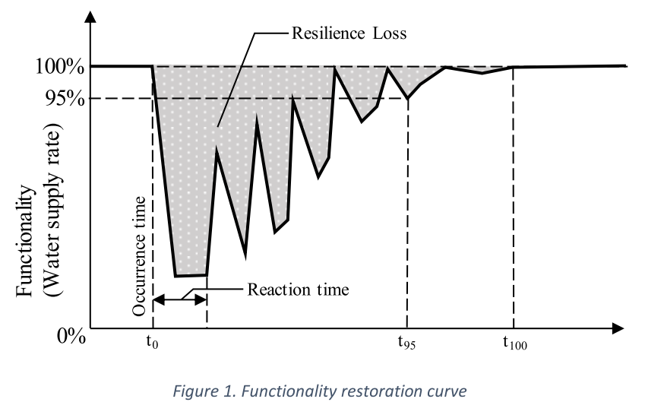
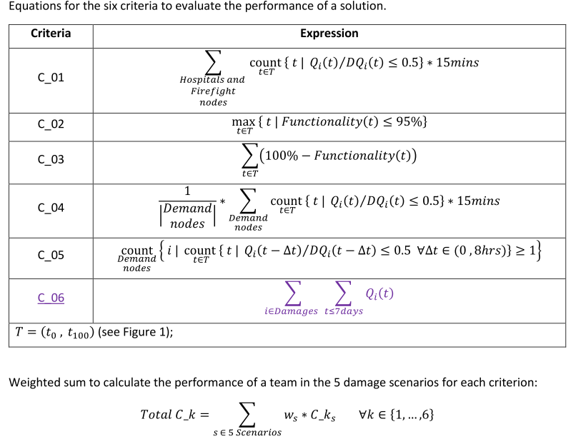
3. Recovery Activity Assignment: The priority of damaged pipeline reparation
EVALUATION OF POST-DISASTER RECOVERY MEASURES
1) Time that the hospitals and the firefighting flows are without supply;
2) Rapidity of recovery (time until the system recovers permanently 95% of its functionality – t95 in Figure 1);
3) Resilience Loss (accumulated loss of functionality from the occurrence of the disaster until full recovery – shaded area in Figure 1);
4) Average time each consumer (node) is without service,
5) Number of consumers (nodes) without service for more than 8 consecutive hours;
6) Volume of water lost during the next 7 days after the event.

Slide 14
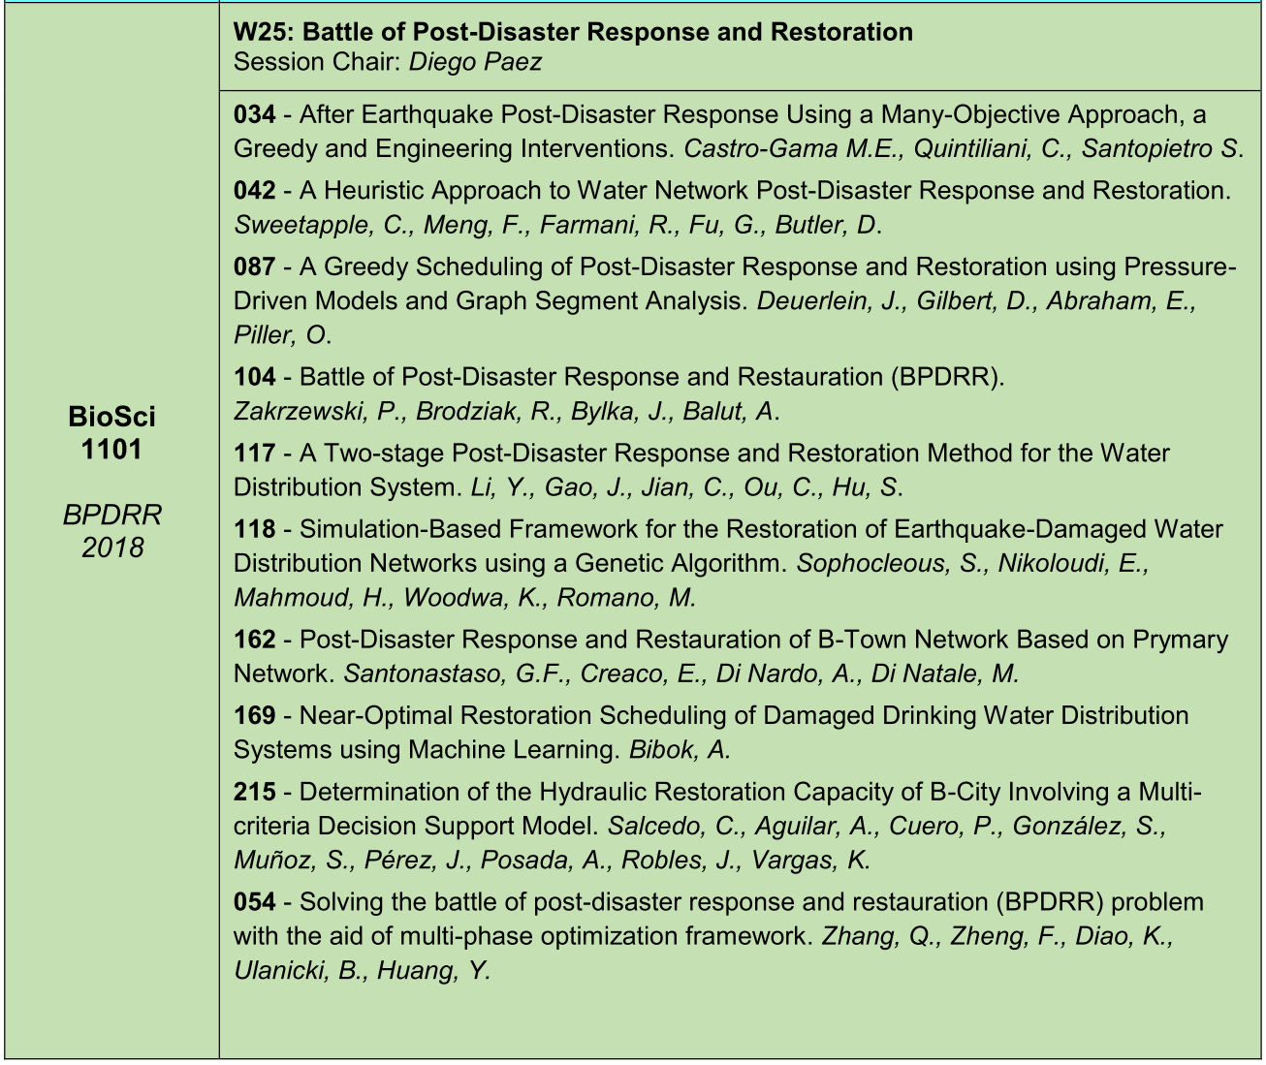
3. Recovery Activity Assignment: The priority of damaged pipeline reparation
Optimization model always takes a long time to solve;
The sequence should be determined before the reparation.
The damages and crews might be changed during the reparation.
Other model ?
Global Optimization Model;
Greedy Scheduling;
Heuristic Approach;

Slide 15
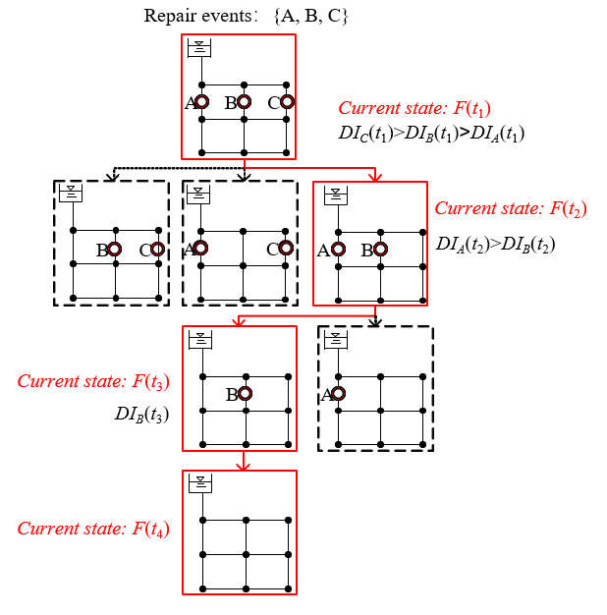
3. Recovery Activity Assignment: The priority of damaged pipeline reparation
Global Optimization Model;
Greedy Model;
Importance Measure(IM), Pre-earthquake sensitivity.
Dynamic Importance Measure(DIM), Post-earthquake sensitivity for each time step.
Heuristic Approach; (Los Angeles, 1994 Northridge EQ, Ms6.6)
Break > Leak;
The distance to source: closer > further;
Bigger Dia. > Smaller Dia.;

Slide 16
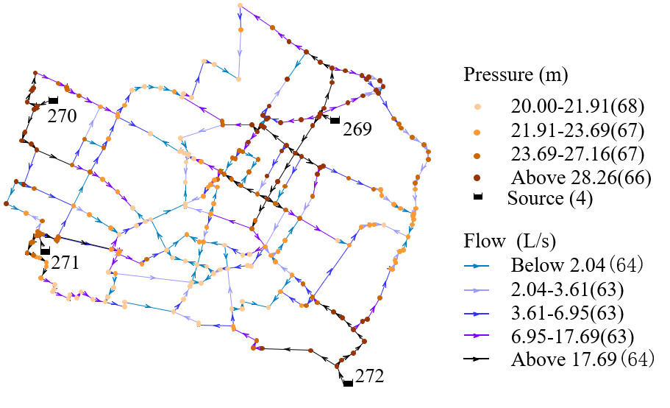
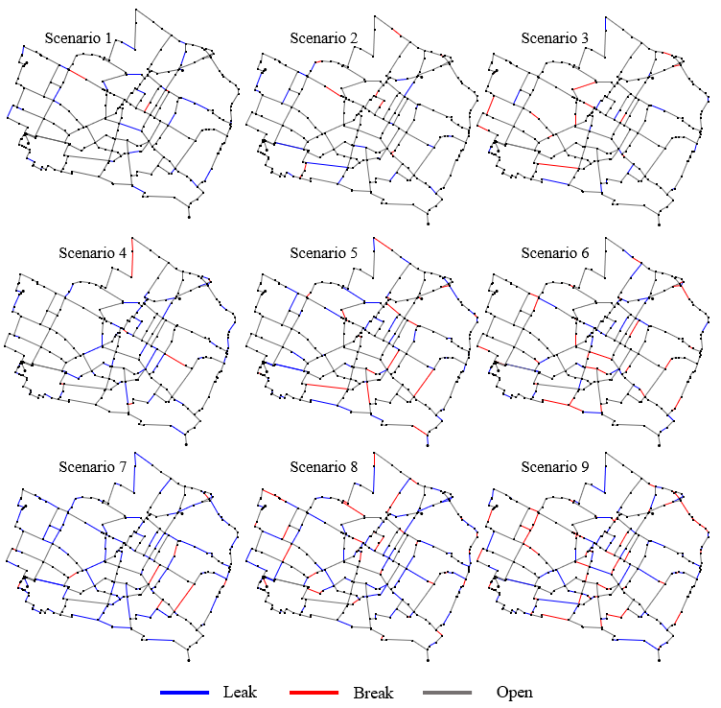
4. Case Study
Modena Network (Bragalli et al., 2012)
268nodes;
317 pipes;
4 Reservoirs;
407 LPS;
Scenario | 1 | 2 | 3 | 4 | 5 | 6 | 7 | 8 | 9
Breaks | 4 | 10 | 16 | 8 | 22 | 36 | 14 | 42 | 69
Leaks | 28 | 22 | 16 | 64 | 50 | 36 | 123 | 95 | 68

Slide 17
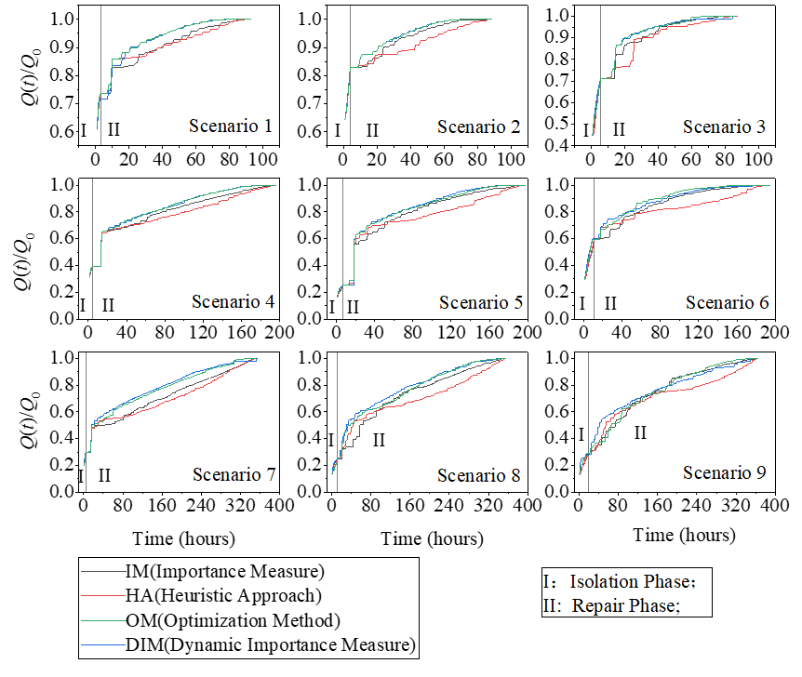
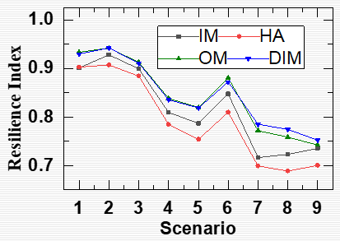
4. Case Study
Modena Network (Bragalli et al., 2012)
The RIs obtained by DIM are close to that of the Optimization Method.
RI((OM-DIM)/OM)
0.98%~2.07%

Slide 18
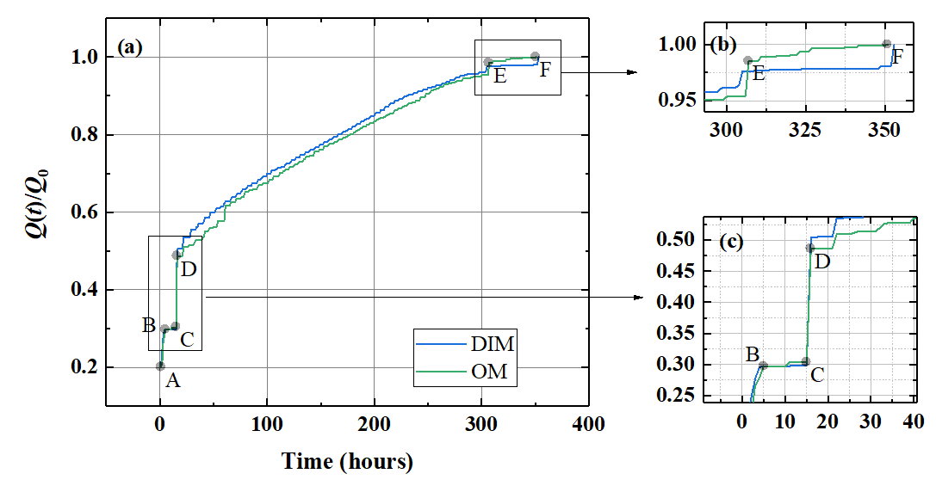
4. Case Study
Modena Network (Bragalli et al., 2012)
Scenario 7
The number of hydraulic simulations of the WDS
Scenario | 1 | 2 | 3 | 4 | 5 | 6 | 7 | 8 | 9
IM | 317 | 317 | 317 | 317 | 317 | 317 | 317 | 317 | 317
HA | 0 | 0 | 0 | 0 | 0 | 0 | 0 | 0 | 0
OM | 649285 | 664143 | 650162 | 2539382 | 2450004 | 2269009 | 6133849 | 4307759 | 3569562
DIM | 631 | 671 | 751 | 2858 | 3677 | 3585 | 9912 | 10712 | 12234
The number of hydraulic simulations of DIM are less than that of Optimization Method.
0.10%~0.34%.

Slide 19
5. Conclusions and Remarks
The post-earthquake performance of the WDS is dramatically different to that of burst events. It is necessary to establish a resilience model according to the earthquake damage records of WDS.
The seismic resilience of WDS are influenced by the recovery sequence of damaged pipes, the priority of reparation should be determined by the model with suitable accuracy, efficiency and time consumption.
The resilience index obtained by the Dynamic Importance Measure(DIM) are close to that of the Optimization Method(OM), whereas the time consumptions of DIM are <1% than that of the OM.
Other Benchmark WDS with EPS hydraulic models should be test by those models.
Even use the Pressure Dependent Demand method, the negative pressure of user nodes still exist.
The generalized post-earthquake recovery strategy should be given by case studies.

Slide 20
The end, thanks.
Comments or Questions?

